Slide 1
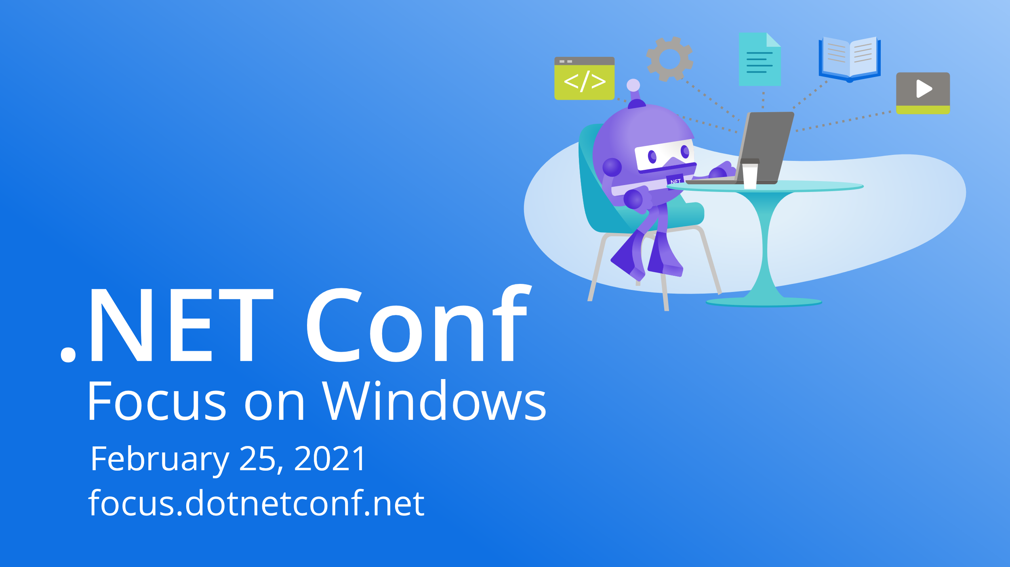

Slide 2

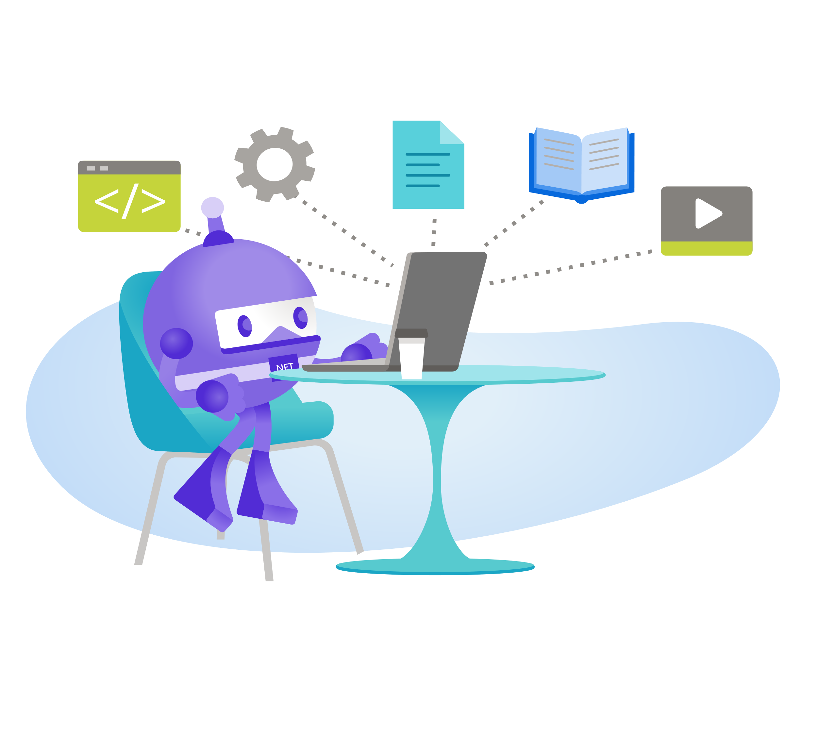
Bringing Desktop Apps to the Cloud with Azure and MS Graph
Javier Lozano

Slide 3

Javier Lozano MVP Developer Technologies, Microsoft Board Member, .NET Foundation Founder, Lozanotek, Inc. Des Moines, Iowa @jglozano javier@lozanotek.com

Slide 4
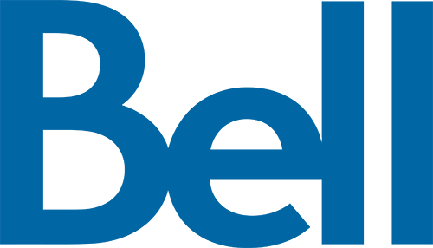
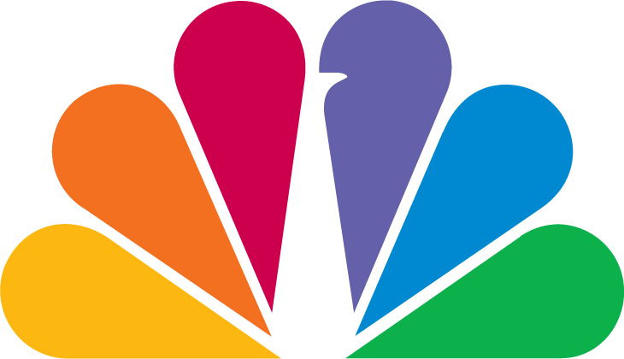

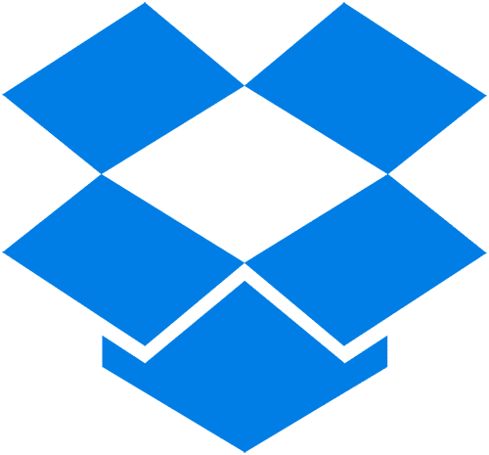



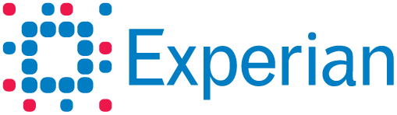
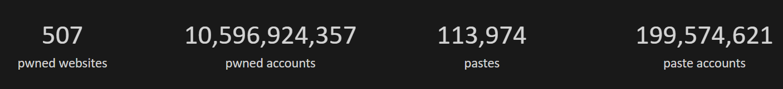



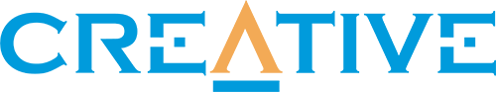
So you want to store your users’ passwords?
haveibeenpwned.com, 02/21/21
Notes:
First, if you have a password database, it’s time to not have that anymore, period. Move ASAP

Slide 5

Azure Active Directory - the world’s largest cloud identity service
Thousands of organizations, millions of active users, billions of daily requests
200K +
Azure AD
Premium organizations
345M +
Azure AD
Monthly active users
30B +
Azure AD
Daily authentication requests
Notes:
DESIGN: potential visual refresh after data refreshed
ADAM: confirm any data updates
Talk Track:
FUTURE-FACING
Microsoft is one of the largest identity providers. The scale of our solution is vast:
Azure AD is a truly global identity service that operates at hyper-scale
Over 100 thousand organizations trust Azure AD
We manage over 254M Monthly active users, with an average of 30 billion daily authentication requests [For comparison, Okta has about 8B authentications PER YEAR.]

Slide 6
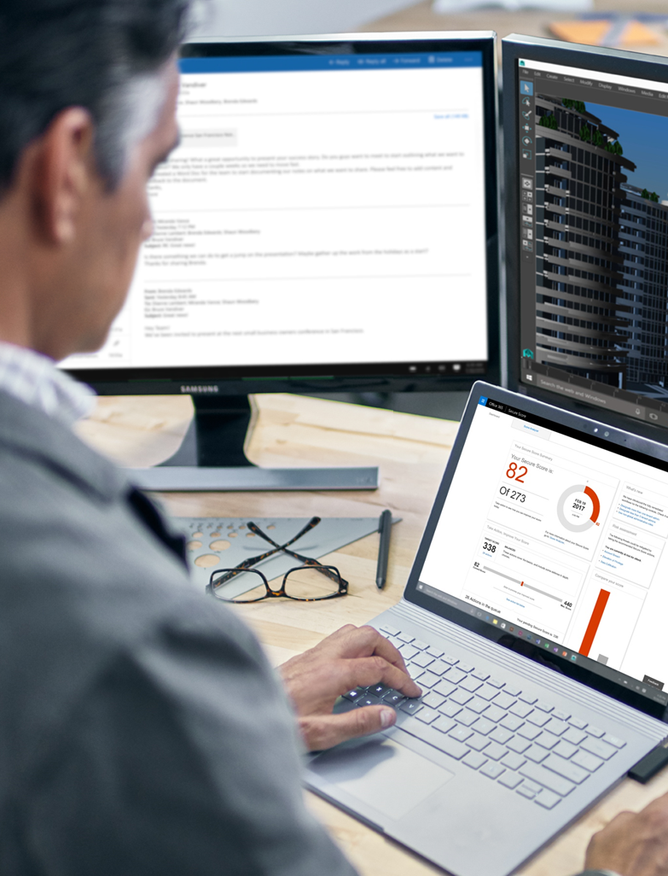
What developers ask for with identity and access management
Can I leverage my company’s existing identity and access management solution to save costs?
How easy is it to quickly get started and build authentication into my applications?
Does it support or integrate well with the platform, language and tools I use?
Does it support advanced security capabilities out-of-the-box, so I don’t have to build it?
Notes:
So let’s start with some of the asks and needs that developers have when it comes to identity and access management (IAM) solutions?
Developers in your organization are likely looking for a couple things when it comes to sign-in and authentication:
How quickly can I get started to build authentication into my apps. Authentication isn’t something many developers have expertise in. Developers are looking to get their app running with authentication and signing-in users quickly so they can focus on the core value of the app or services.
Is the identity platform well integrated with the tools, languages and platforms I use. Does it support mobile platforms? Does it support the programming languages I use? And is it well integrated into my workflow and the dev tools services I use.
Is the platform feature rich and will it support continuous identity innovation and security. Developers don’t want to get in the business of building IAM features into their app or storing username and passwords. That’s best left to experts.
If my company is using an IAM solution for their employees, can I use that solution when building my applications to help save costs? Can I use the IAM solution that my company uses to sign-in users to Office 365 with my applications? Microsoft has the leading enterprise IAM solution with Azure AD, which is built-in with Office 365 that you can also leverage for the apps you build.

Slide 7
Microsoft identity platform for developers Simplifying authentication and authorization so you can focus on building innovative applications
Reduce sign-in friction
Access organizational data
Comply with IT
Safeguard access
Simplify sign-in to your app and reach millions of users
Customize, extend or connect your apps to APIs such as Microsoft Graph
Meet enterprise security and compliance requirements
Protect access to your app to only authorized users
Notes:
Leverage the Microsoft identity platform when building applications. Why?
Same time and focus on core product differentiation. Lower cost of development – no more building infra to store username and passwords
Better user experience – allow users to use their preferred identity to sign in to their applications.
Ensure Platform security and get the latest in identity innovation without building it
And on top of that when you integrate with Microsoft identity platform, you’re able to access users and data in the MS cloud. Which enables you to build rich applications.

Slide 8



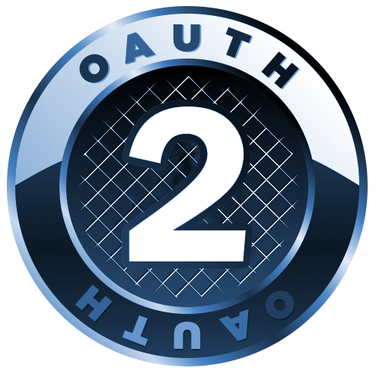



Microsoft identity platform for developers A toolkit to integrate identity and authentication into your apps
Azure portal and
Microsoft Graph App API
Microsoft Authentication Libraries
For clients and services
App registration
Libraries
Web API
Including Microsoft Graph, Azure, and your own APIs
OIDC Certified Endpoints
Web API
Endpoints
Work and school accounts
Azure AD
Personal accounts
MSA
Customer and Partner accounts
Azure AD External Identities (includes Azure AD B2C)
Supported identities
Industry standards
Notes:
So what does the Microsoft identity platform consist of?
You have:
One portal to register all your applications
One set of Microsoft Authentication libraries for building web, mobile and desktop apps with your favorite programming langague
One endpoint, that is standards compliant, that sign-in any Microsoft identity, which allows compatibility with third-party libraries.
Secure access to APIs – from Microsoft Graph to Azure resources to your own protected APIs
This gives you the ability to authenticate any Microsoft identity including work or school accounts or personal accounts. And your application can sign any external user such as customers and partners social identities and local accounts.
And our platform supports open industry standards. So if you have an existing application based on industry standards it’s straightforward to connect your application.

Slide 9

Come as you are
Bring your own developer tools, services & platforms

Slide 10




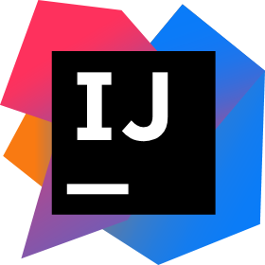
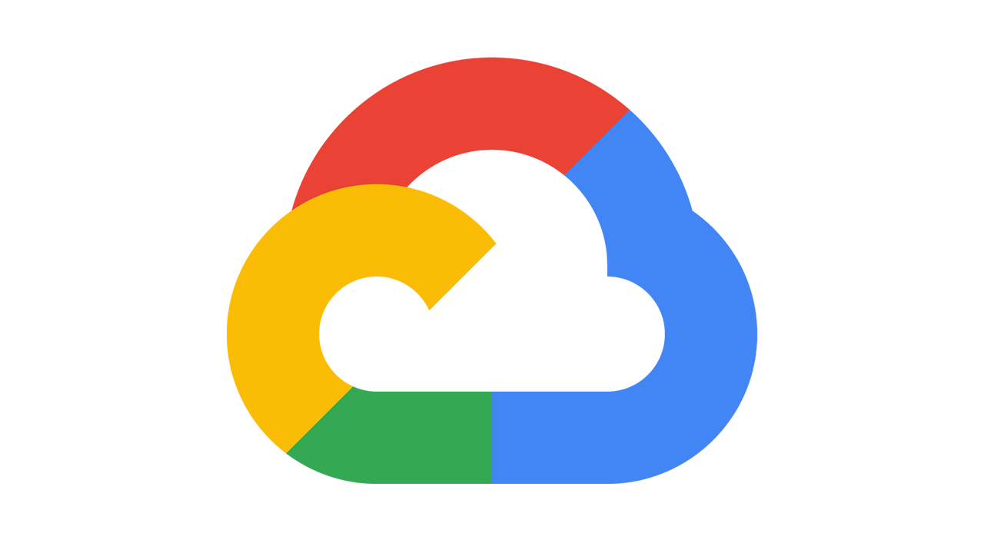

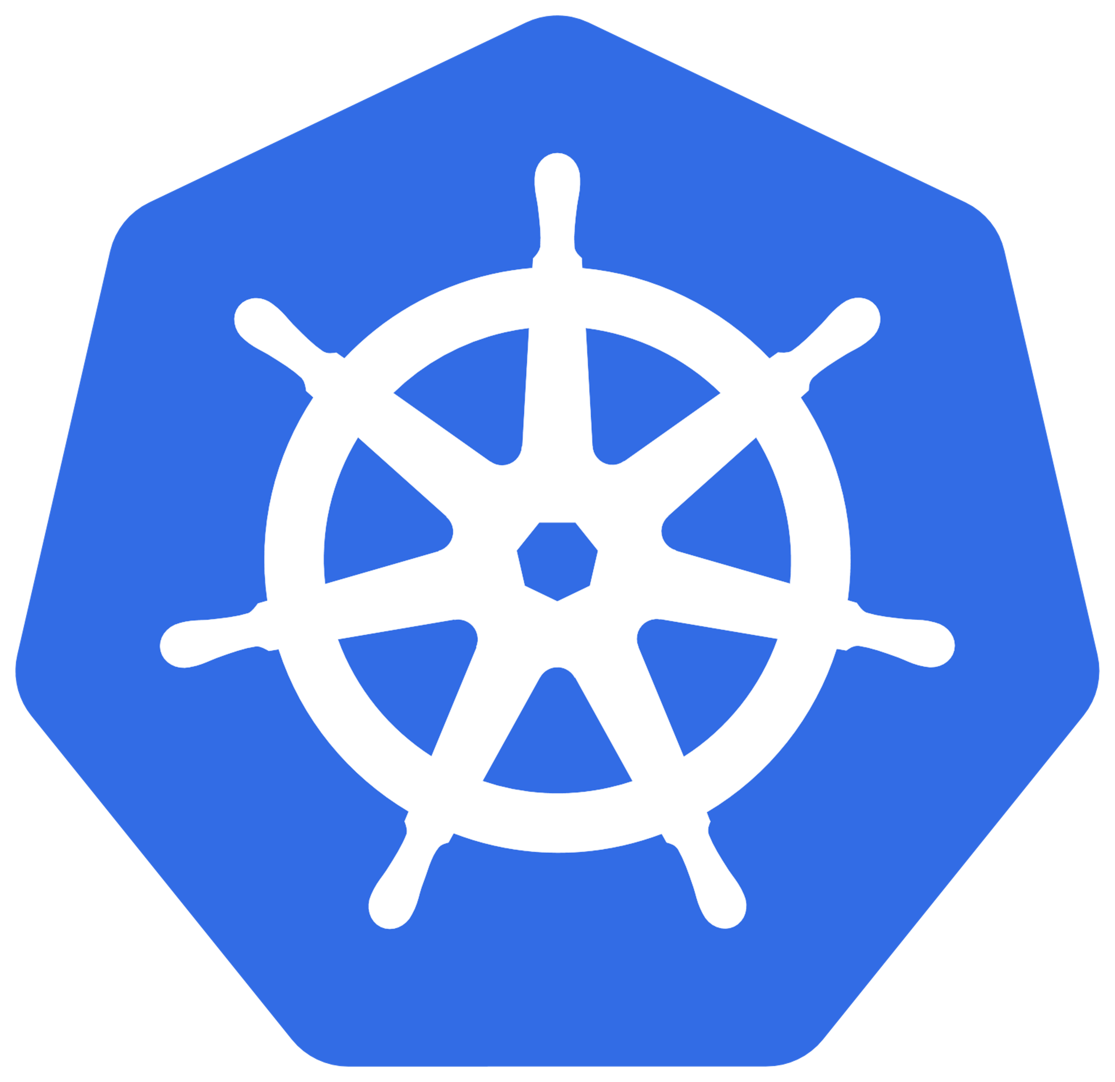
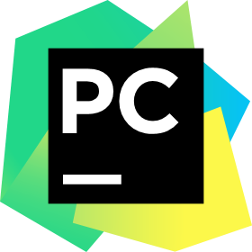



Bring your own developer tools, services and platforms
Identity
Any cloud
Any language
Bitbucket
Serverless
Amazon Web Services
Java
IntelliJ IDEA
Kubernetes
Google Cloud Platform
Python
PyCharm
Bare metal
DigitalOcean
Javascript
…or on-prem
and many more…
Notes:
Every company wants to digitally transform and we see organizations reaping real, tangible benefits - the positive outcomes are truly amazing.
One group of people that is a catalyst for digital transformation are developers. Developers are the builders of our era, creating the ideas and writing the code that enables digital transformation for organizations around the world. They are at the heart of innovation.
It’s why the Microsoft identity platform is woven into the tools, service and platform developer use today. From IDEs like Visual Studio, to popular Azure services like App Service, Functions or Kubernetes to low code solution like power apps, the Microsoft identity platform is integrated into the workflows of these services.
We want to enable any developer to easily get started with the Microsoft identity platform using the tools and services they know and love.

Slide 11



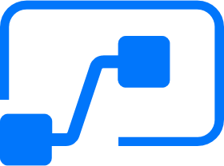
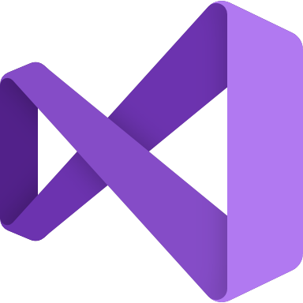


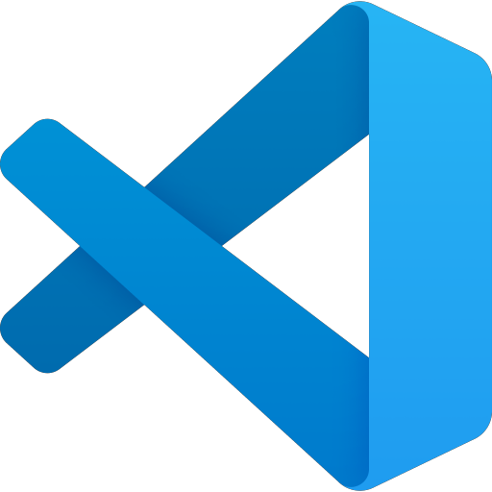
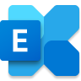

Integrated with Microsoft’s developer ecosystem
Identity
Microsoft 365 platform
Azure services
GitHub
Power Automate
Teams
App Service
Visual Studio
Power Apps
SharePoint
Azure Kubernetes Service
Visual Studio Code
Power Virtual Agents
Exchange
Functions
…
…
Notes:
Every company wants to digitally transform and we see organizations reaping real, tangible benefits - the positive outcomes are truly amazing.
One group of people that is a catalyst for digital transformation are developers. Developers are the builders of our era, creating the ideas and writing the code that enables digital transformation for organizations around the world. They are at the heart of innovation.
It’s why the Microsoft identity platform is woven into the tools, service and platform developer use today. From IDEs like Visual Studio, to popular Azure services like App Service, Functions or Kubernetes to low code solution like power apps, the Microsoft identity platform is integrated into the workflows of these services.
We want to enable any developer to easily get started with the Microsoft identity platform using the tools and services they know and love.

Slide 12
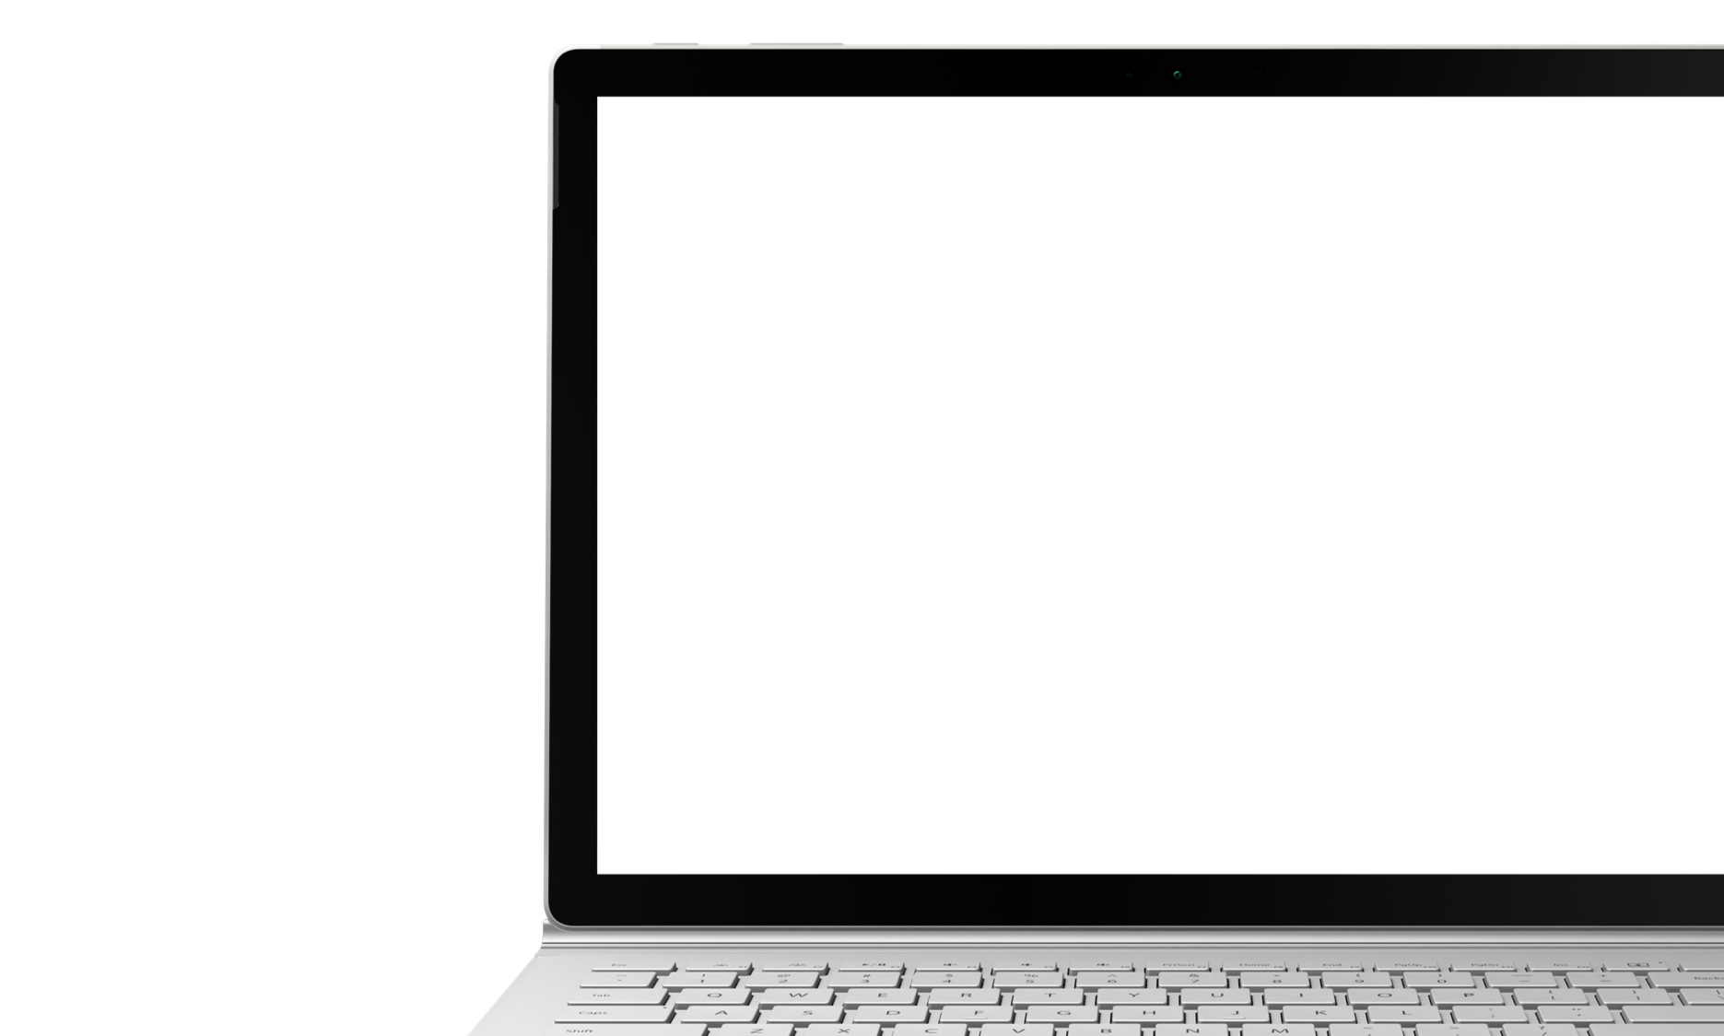
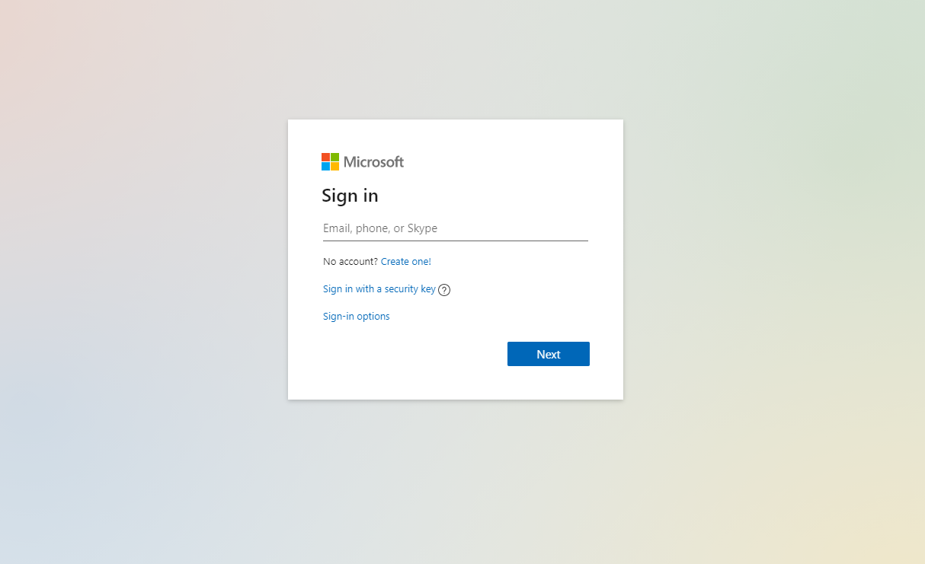

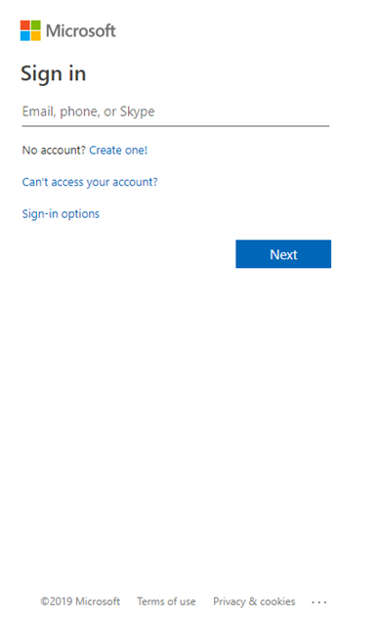
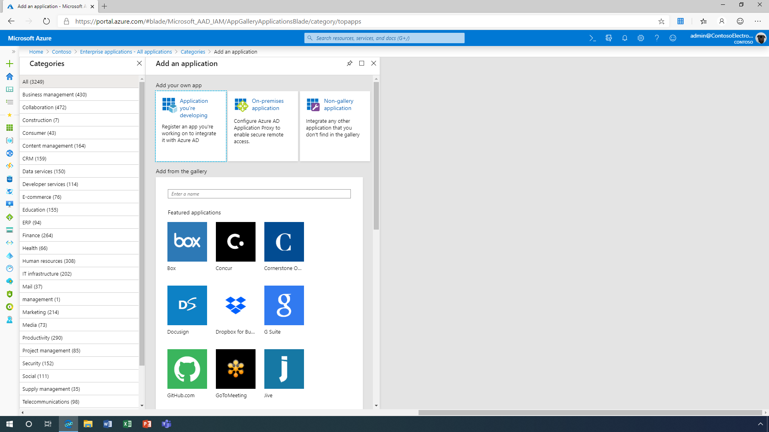
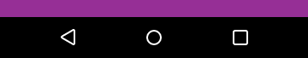
Ways to integrate single sign-on
OpenID Connect and OAuth
Best when developing new apps. Simplifies app configuration, has easy-to-use SDKs, and enables your application to use Microsoft Graph.
SAML integration
Best for existing applications that do not use OpenID Connect or OAuth.
Mobile SSO
Leverage System Browser for authentication in order to support single sign-on for your mobile app.
Notes:
Here are some ways you can integrate and support SSO. You can use your protocol of choice.
For OpenID Connect and OAuth: use OIDC and Oauth when developing new apps. This simplifies app configuration, has easy-to-use SDKs, and enables your application to use Microsoft Graph.
For existing apps that are SAML based we support SAML integration.
For your mobile apps – be sure to support system Browser for authentication in order to support single sign-on with Azure AD
-----
Integrate single sign-on with OpenID Connect/OAuth or SAML
https://docs.microsoft.com/en-us/azure/active-directory/manage-apps/what-is-single-sign-on
Add sign-in with Microsoft button to your application
https://docs.microsoft.com/en-us/azure/active-directory/develop/howto-add-branding-in-azure-ad-apps
Customize sign-in and sign-up experiences with Azure AD B2C
https://docs.microsoft.com/en-us/azure/active-directory/develop/howto-add-branding-in-azure-ad-apps

Slide 13
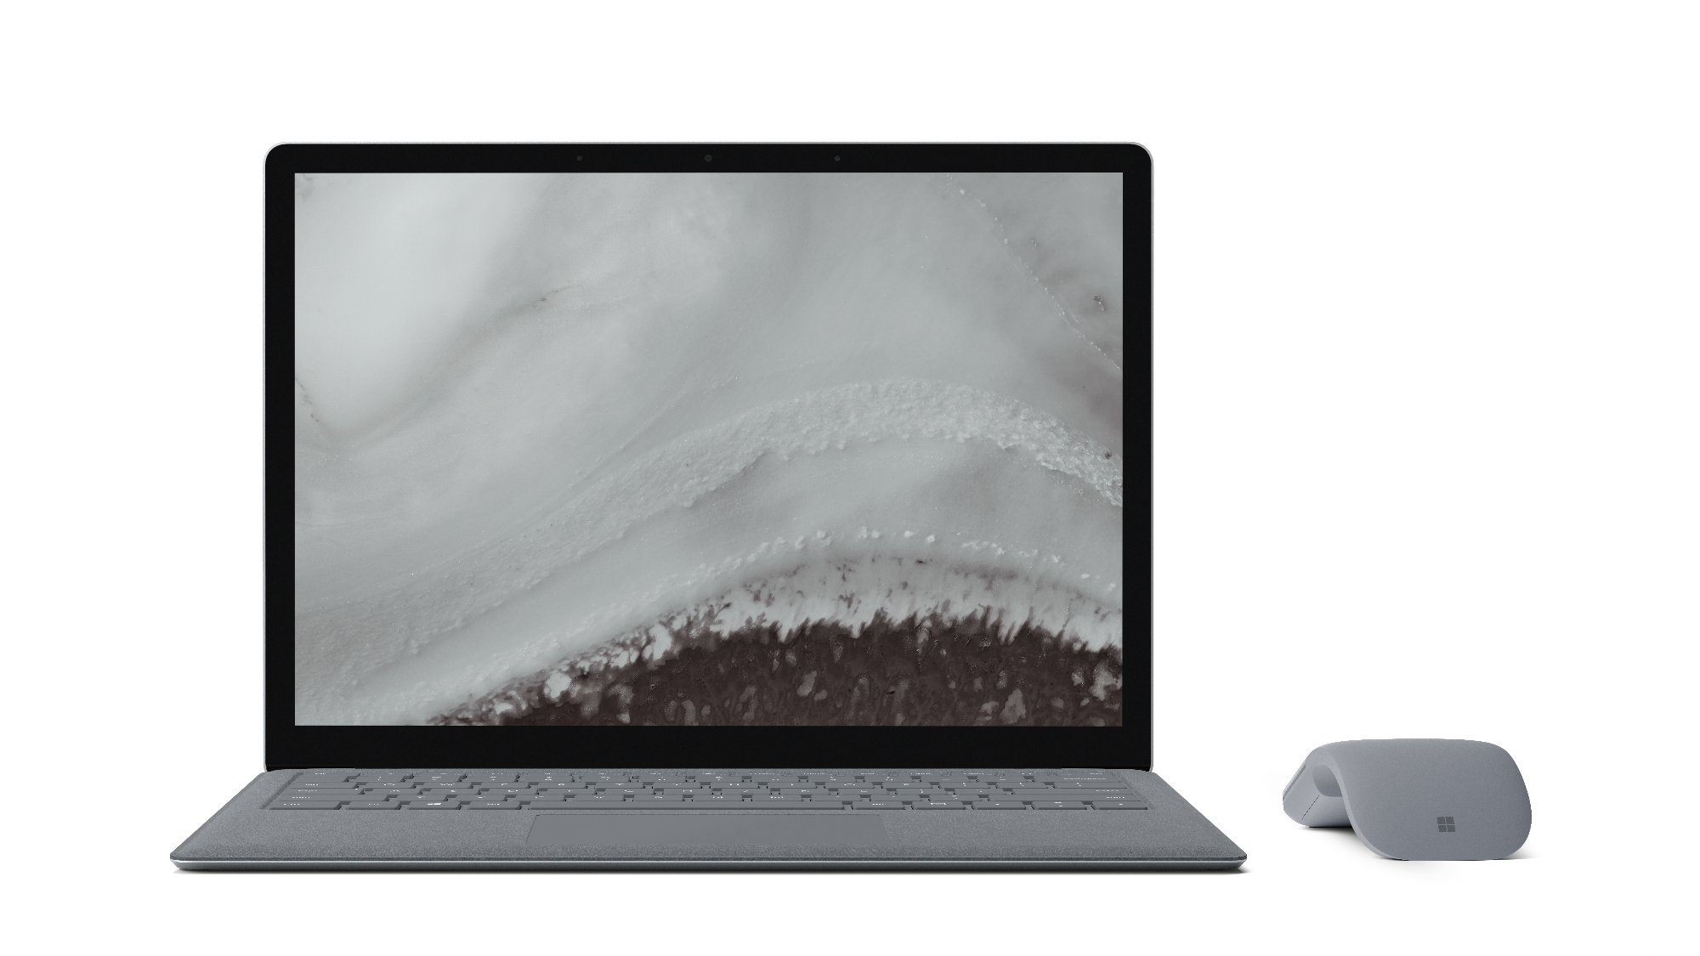
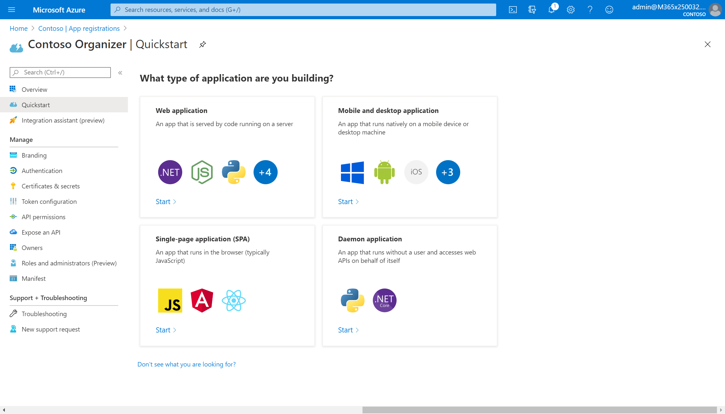
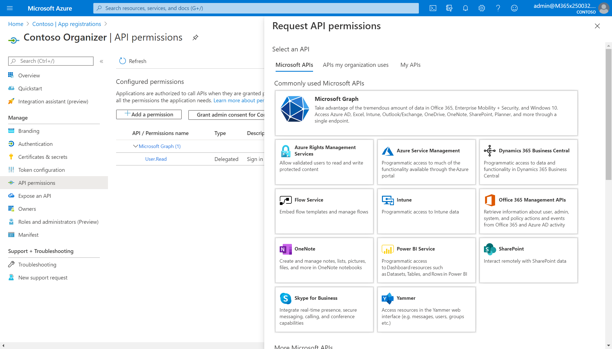
Simplify sign-in with our authentication libraries Fastest, simplest integration with the Microsoft identity platform
Develop in your favorite language
Best in class authentication libraries that work with your platform or language of choice or use our OIDC certified endpoint.
Secure by default
Applications using MSAL are secure by default and can comply with security policies implemented by IT.
Build richer experiences
Secure access to users and data from Microsoft Graph, Azure or your own protected APIs.
Notes:
With our Microsoft Authentication libraries – often referred to as MSAL – we’ve made adding authentication into your apps easy. With our MSAL libraries you can sign-in users and acquire security tokens to call protected APIs.
The Microsoft Authentication Libraries represent our best developer experience for easily integrating authentication into a diverse set of applications. For building modern applications that authenticate Microsoft identities, your app should be using our most advanced and up-to-date libraries and protocols. Our MSAL libraries support a variety of platforms and languages - .NET, Javascript, Java, Python, Angular, iOS, Android and we also recently released Microsoft.identity.web which is the glue between ASP.NET Core and MSAL.NET.
When you use our MSAL libraries you applications are secure by default. MSAL makes it easy to implement the right authentication protocols and allows developers to get the latest identity innovations such as passwordless, Conditional Access and additional security features into applications with just a few lines of code.
On top of that you can securely access to users and data in the Microsoft Cloud such as data in Microsoft Graph or Azure. You can also call your own protected API.
So let’s take a look how easy it is to get started.
Use Microsoft Graph to build experiences around the user's unique context to help them be more productive. Imagine an app that...

Slide 14









Create seamless, connected experiences with Microsoft Graph
Build custom solutions with the Microsoft Graph API
Microsoft identity
Incorporate the richness of an organization’s data
Microsoft Graph
Bring personal context into the flow of work
Applications
Notes:
As you may have noticed throughout the discussion and the others today, we are very focused on identity and it’s at the center of focus. And identity allows you to build new experiences by connecting to Microsoft Graph comes.
Microsoft Graph is the Microsoft 365 data that describes patterns of productivity, identity, and security in an organization, accessed through a unified API endpoint. It connects apps and devices with powerful cloud services – and puts them all to work for you.
With the Graph API, you can build custom solutions which both leverage a customers organization’s data, directly from the source, as well as create a personalized experience directly in the flow of your users’ work.

Slide 15
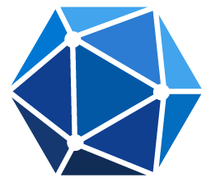
Enrich your apps with Microsoft Graph
The gateway to data and intelligence in Microsoft 365
Extend Microsoft 365 experiences
Build your experience
Documents
Conversations
Portals
Timeline
Search
Web apps
Bots and agents
Device and native
Daemon apps
Workflow automation
Analytics apps
Microsoft Graph API
Microsoft 365
Your local data
Azure platform
People
Chats
Files
Devices
Mail
Alerts
Lists
Security
Search
Events
Microsoft Graph
data connect
Connectors
Microsoft Identity
Notes:
Once you signed-in a user and authenticated you can start to access data in Microsoft Graph.
It's best to think of Microsoft Graph as an API gateway that unifies the many REST API offerings we have as a company. Today, Microsoft Graph brings together more than 25 incredibly important APIs including Azure Active Directory, productivity APIs like Exchange and OneDrive, security and management APIs like Intune and Security Graph, Windows APIs like Rome and Cloud Print, and much, much more.
By leveraging the Microsoft Graph you can build better apps with:
Rich context. Get rich context for your applications, such as who someone's manager is, whether they are out of office, or what documents they've been working on.
Deep insights. Access deep insights generated from usage patterns, such as trending documents, best team meeting times, or who people typically work with.
Real-time updates. Respond to changes in Microsoft Graph data in real time. Reschedule a meeting based on responses, notify others when a file is modified, or continue a process after it's been approved.

Slide 16

Win App AAD + MS Graph Demo
https://lzno.tk/winapp-aad-graph-demo

Slide 17
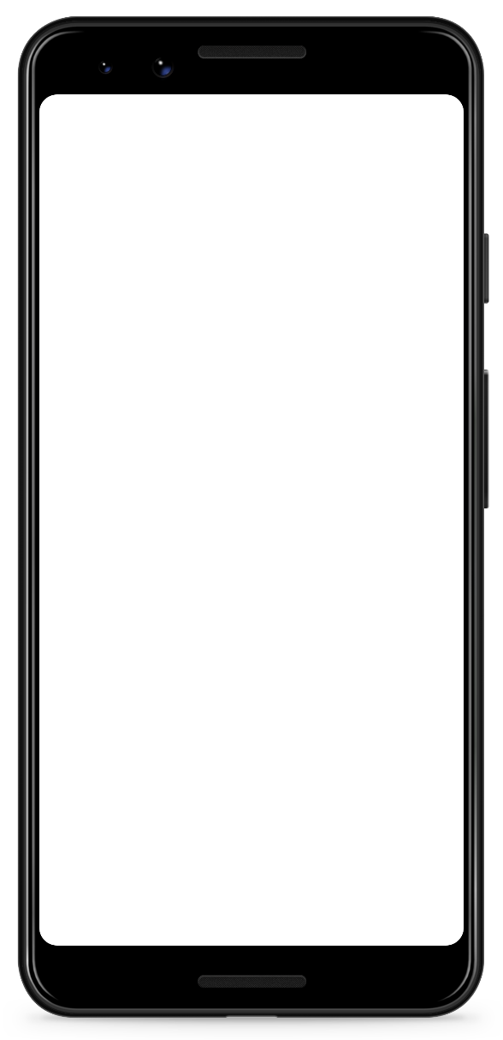
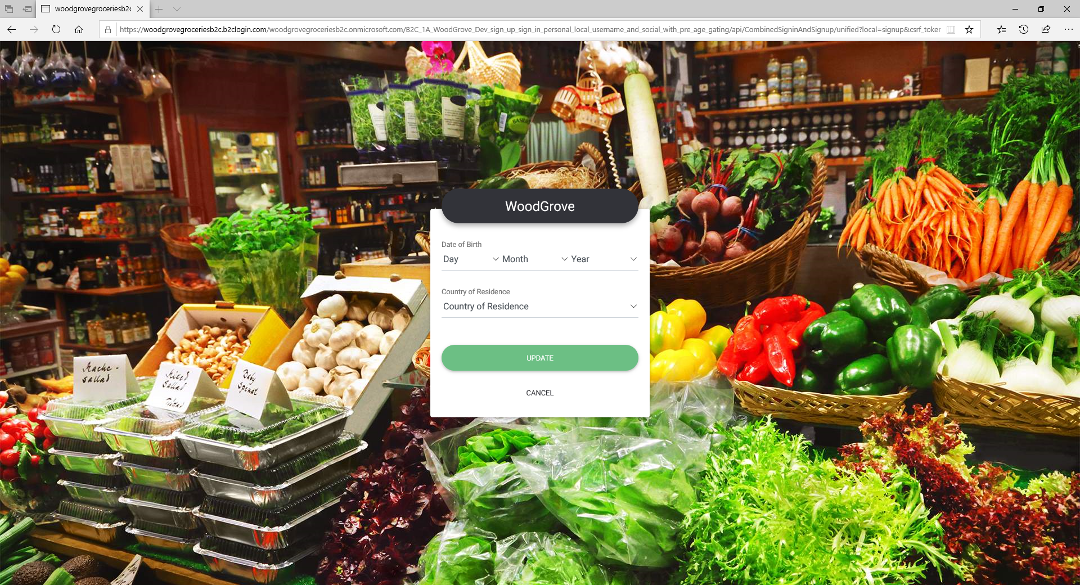
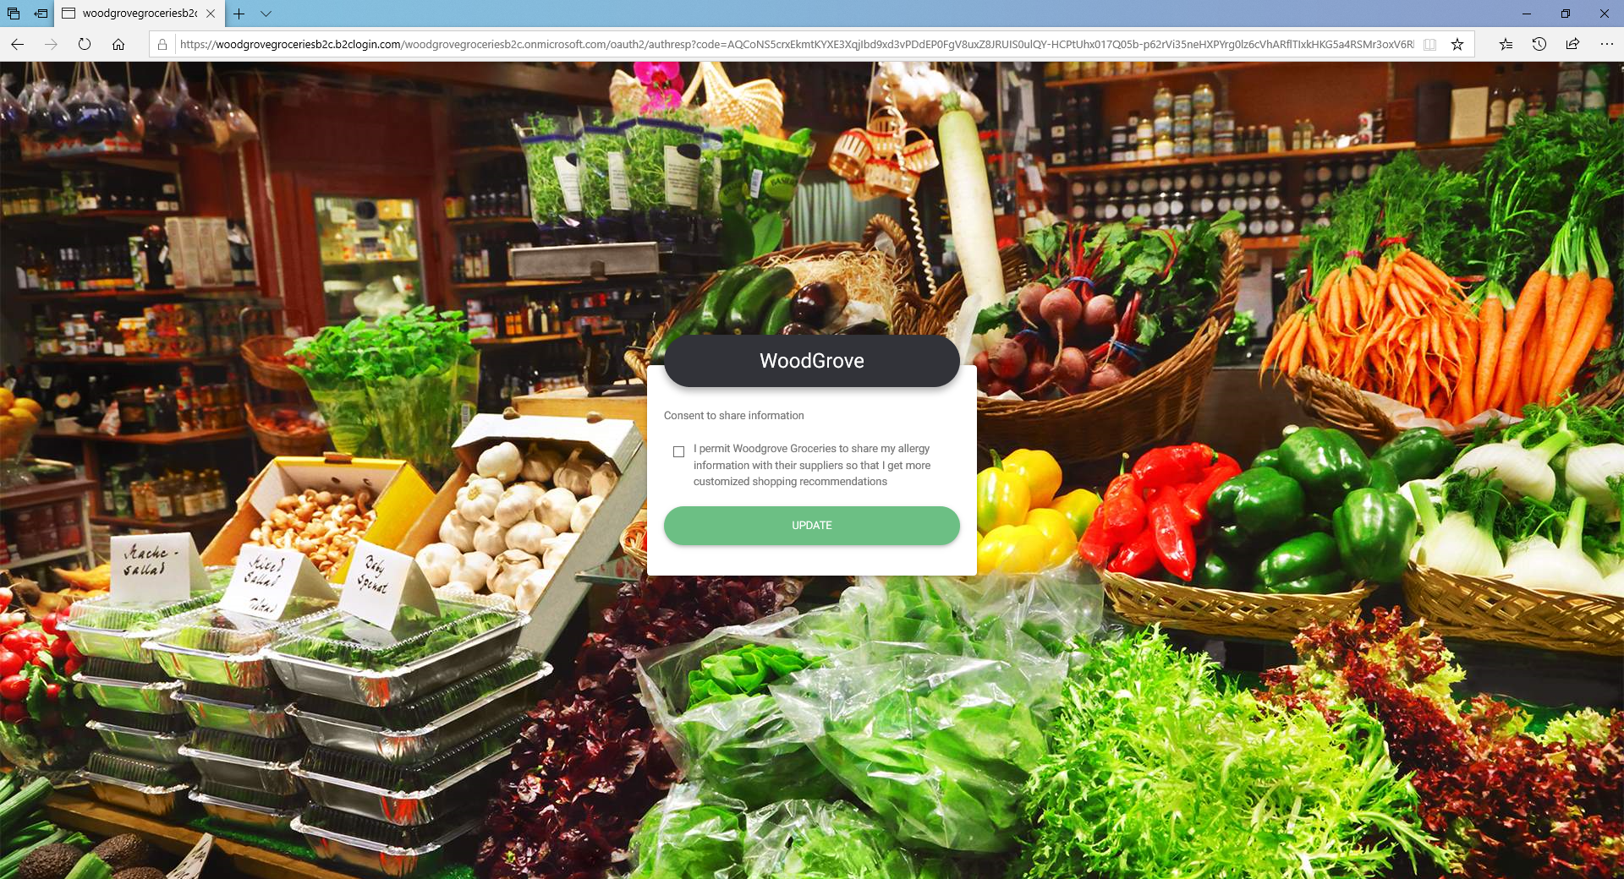
Engage with customers, consumers, and citizens
With Azure AD B2C, organizations can create better customers experiences by:
Eliminating friction from the customer experience
Enable seamless and secure sign-in and sign-up
Customizing the user experience
Customize every pixel with Microsoft’s identity experience framework
Scaling with your customer growth
Support millions of active users as your business grows
Notes:
Depending on ISV…. talk about B2C if they it’s a qualified opportunity in that they are looking to embed auth system into an app they are building.
Eliminating friction in the end-user experience is a top priority for organizations and developers engaging consumers, customers, or citizens. With Azure AD B2C, organizations and developers have the flexibility to tailor the identity experience of their customer-facing apps and services so it’s aligned with their brand and business requirements—without sacrificing security.
Seamless and secure sign-in experiences: With Azure AD B2C, you can provide simple, reliable, and secure SSO access to customer-facing apps with customers using their preferred, already-established social, enterprise, or local account identities, while also protecting your customers and data.
Customize the user journey: Azure AD B2C sign-up and sign-in policies allow you to control behavior by configuring settings, such as account types that consumers use, attributes that are collected from the consumer during sign-up, multi-factor authentication (MFA) usage, and the look and feel of all registration and authentication pages.
Design the user experience: Designed to offer you flexibility and control, these customization capabilities include white-label features that allow you to design the entire user experience to blend seamlessly with your web and mobile applications.

Slide 18




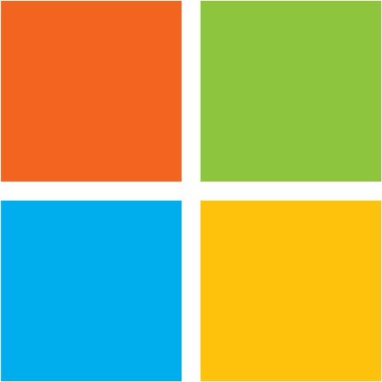





Eliminating friction from the customer experience
Enable seamless and secure sign-in and sign-up
Connect users with corporate or personal Azure AD identities, or any OpenID Connect provider
Business
Azure AD B2C
API
contoso
Web App
Mobile App
Add external users with non-traditional IDs, including email one-time passcode
Add external users with MSA, social IDs, or other SAML providers
Notes:
Organizations may leverage Azure AD B2C to connect external users to external web and mobile apps using a wide range of social identity providers, OpenID Connect, and OAuth 2.0.

Slide 19
Win App B2C Demo
https://lzno.tk/winapp-b2c-demo

Slide 20

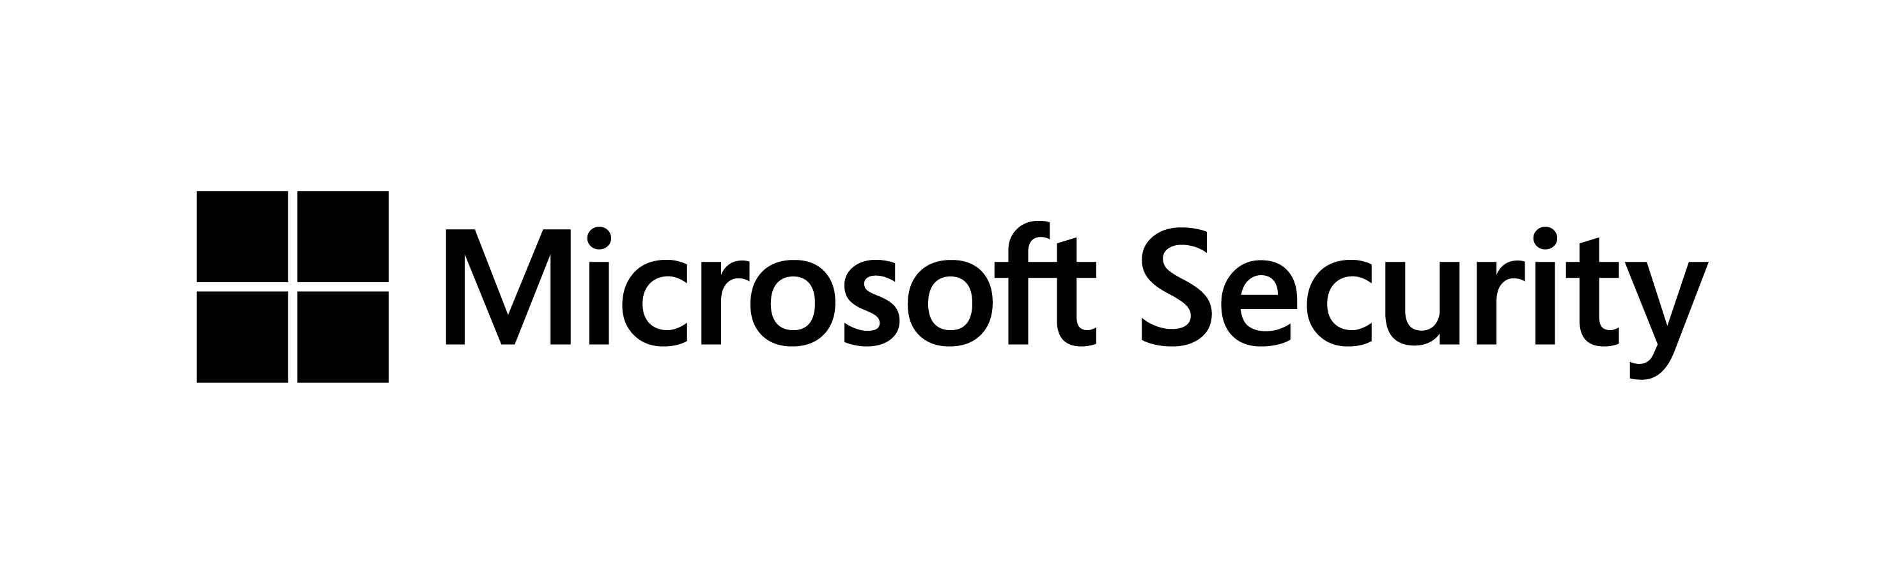
You’re invited to learn from industry experts inside & outside of Microsoft. Interactive, informal & engaging format. https://aka.ms/425show Tuesdays. Thursdays. 8APT 11AET 4PUK 5PCET

Slide 21
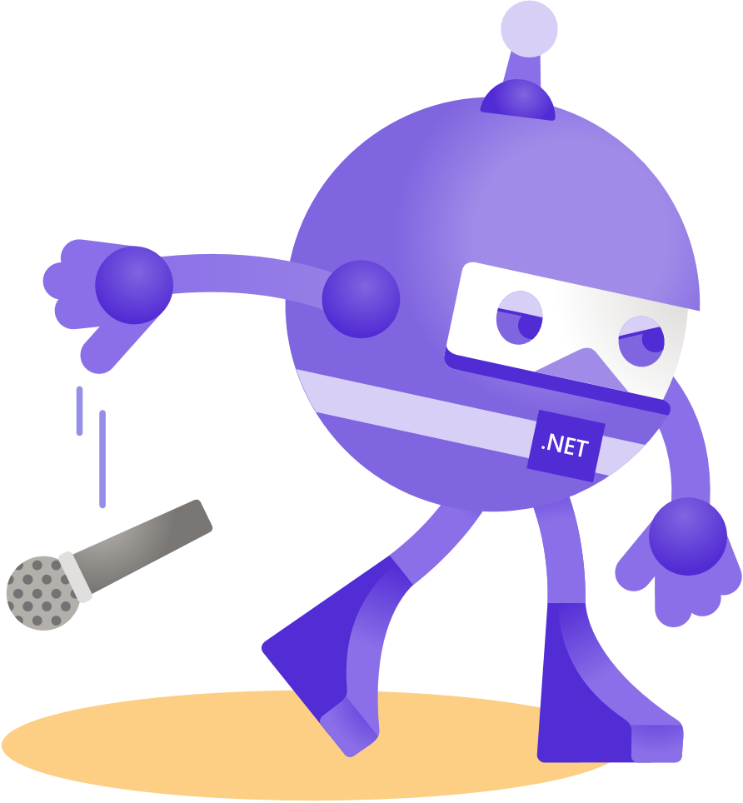
Thanks for joining!
Ask your questions live on Twitter #dotNETConf

